Slide 1
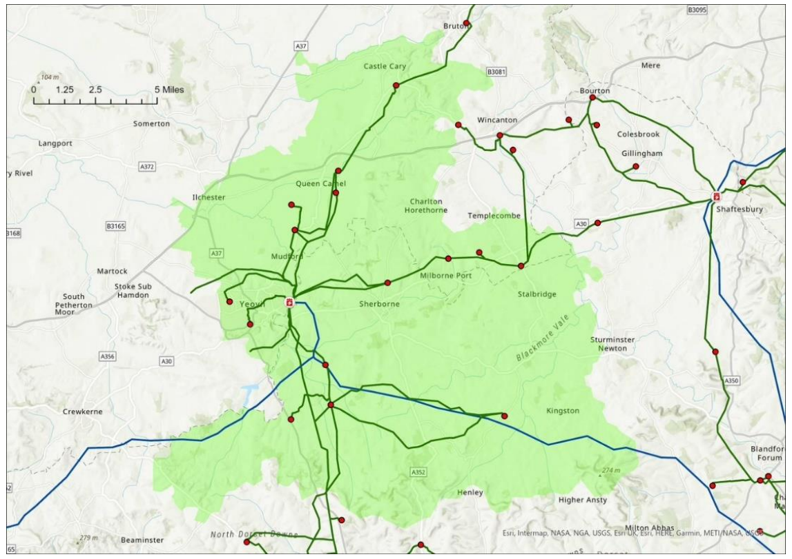
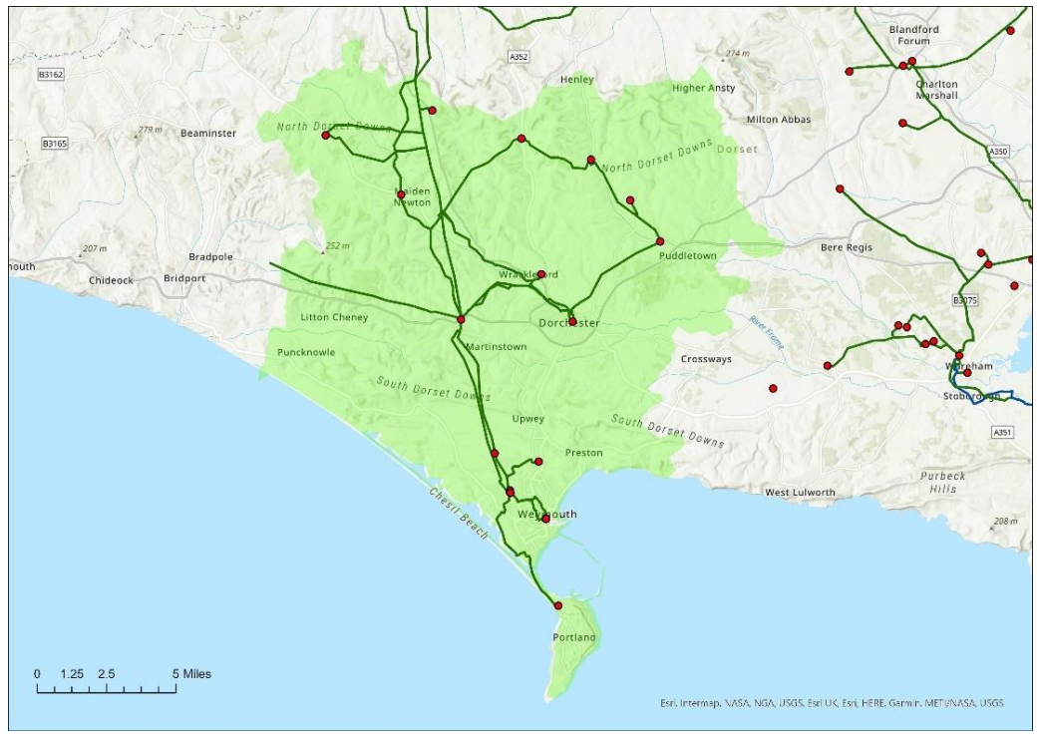
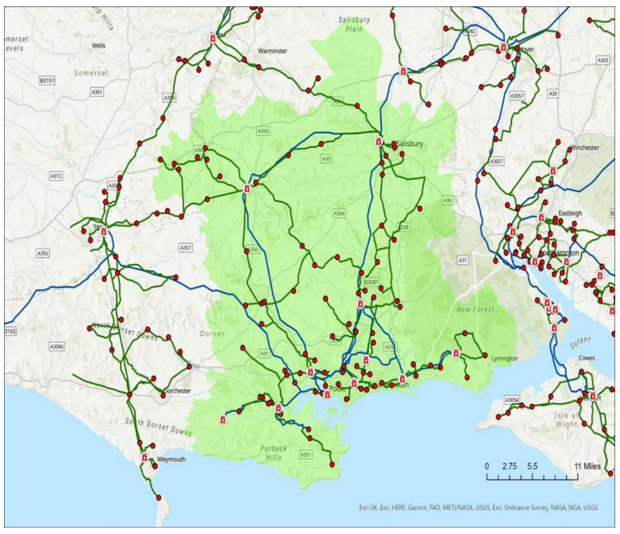



Getting buy-in for a LAEP:
Steps for a Scrutiny Grid Review
11 February 2025

Slide 2

Purpose and rationale
The problems:
1. Buy-in:
Given the costs and a lack of statutory duty, how can we get buy-in from members and senior leaders to develop a LAEP or get them enthused about RESPs?
2. Upskill and enthuse:
How can we upskill members and officer to be better informed about a very complex topic?
The solution:
A structured scrutiny activity – basically a mix of tutorial and oral evidence-gathering. Not a commissioned technical study/report.
It’s a simple and replicable approach for a way to develop support and enthusiasm for energy planning, using grid constraints as a route in (rather than, say, renewables).
If you want to do something similar, you could largely lift the template materials with minor modifications.

Slide 3
Background and objectives
Main objectives:
  Grow understanding and awareness of the issues to enable better engagement and advocacy;
  Gather evidence from key stakeholders on local impacts, and possible solutions – and get buy-in to go further through a LAEP
  Strengthen links with network operators and form a wider view of how the council could best mitigate risks and exploit opportunities for Dorset
1
2
3
It aimed to convey and elaborate on three fundamental points:
  There’s significant strategic risks to the grid, and they threaten to worsen as more sources of demand and supply aims to connect.
  There is a significant programme of reform underway nationally from Government, Ofgem and network companies.
  This presents significant opportunities for the council to play a more strategic role in the emerging future energy system.
1
2
3
The focus was limited to electricity grid constraints, rather than broader energy system challenges, to keep it manageable. And it wasn’t framed just as a net zero issue – but maintained broader focus on development and economic issues/impacts too.
Notes:
The need for this exercise emerged organically – as instances of grid related challenges grew in frequency, both councillors and officers became increasingly aware of issues in connecting to the electricity network facing organisations and businesses across the county.
So in early 2023, representatives of the Places and Resources Scrutiny Committee convened with officers from the Sustainability, Planning, and Economic Development teams to discuss a way forward. They recognised that the complexity of the issue required a new approach to scrutiny and established an eight-person, cross-party task and finish group - led by the then Scrutiny chair Cllr Shane Bartlett and supported by the sustainability team. The group was cross-party to ensure stronger buy-in to the eventual recommendations.

Slide 4
1.
2.
3.
4.
Structure of the process
Supporting materials
Final report:
  Issues, impacts & solutions
  Primary diagnoses
  Key implications & recommendations
  Appendix on reforms
Outcome and next steps

Slide 5
1. Structure of the process

Slide 6
Structure of the process
Who?
8 member, cross-party, scrutiny task & finish group
Supported by 1x officer and 2x Corporate Directors (for Sustainability, and for Planning & Ec Growth)
How?
5 sessions totalling 12hrs (and a bit)
Spread over 5 days across Oct 23 to Jan 24 – but you could condense this into a much shorter timeframe if you wanted to.
Session 1:
Introductory
background briefing
Session 2:
Info gathering with council officers
Session 3:
Info gathering with local stakeholders
Session 4:
Info gathering with local stakeholders
Session 5:
Review, recommendations & next steps
2hrs
2hrs
4hrs
2hrs
2hrs
*The first four sessions did overrun by 30min to 1hr

Slide 7
Structure of the process
Session 1:
Session 2:
Session 3:
Session 4:
Session 5:
What the grid is
How the grid is changing
Session 1: Introductory background briefing
The first session was dedicated to:
Setting out and agreeing the parameters of the review.
Delivering a background briefing on the key terms, roles and processes.
What network operators are
How forecasting, network planning & investment works
What are the constraints locally
How is policy changing

Slide 8
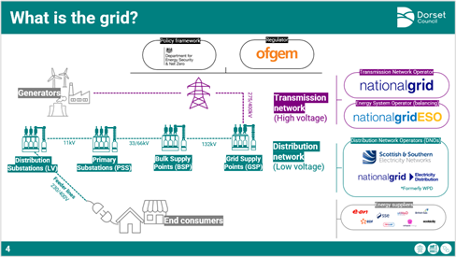
Structure of the process
Session 1:
Session 2:
Session 3:
Session 4:
Session 5:
What the grid is
How the grid is changing
What network operators are
How forecasting, network planning & investment works
What are the constraints locally
How is policy changing

Slide 9
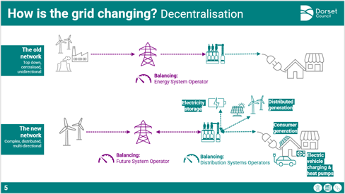
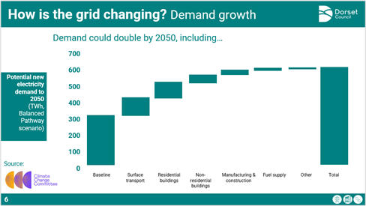
Structure of the process
Session 1:
Session 2:
Session 3:
Session 4:
Session 5:
What the grid is
How the grid is changing
What network operators are
How forecasting, network planning & investment works
What are the constraints locally
How is policy changing

Slide 10
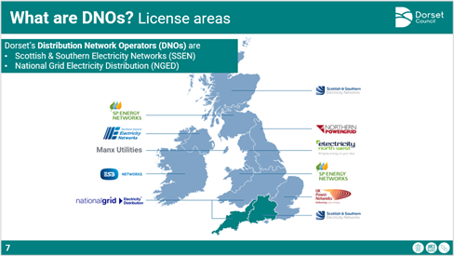
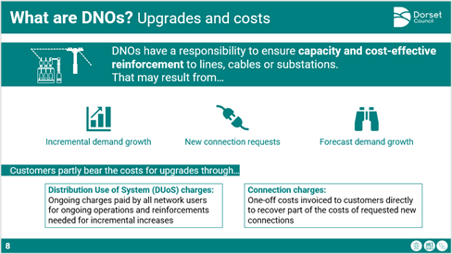
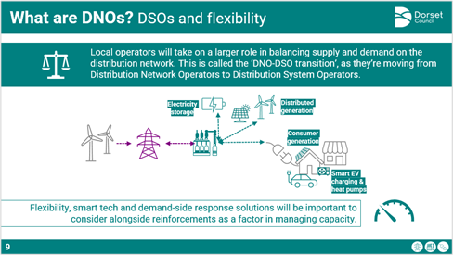

Structure of the process
Session 1:
Session 2:
Session 3:
Session 4:
Session 5:
What the grid is
How the grid is changing
What network operators are
How forecasting, network planning & investment works
What are the constraints locally
How is policy changing

Slide 11
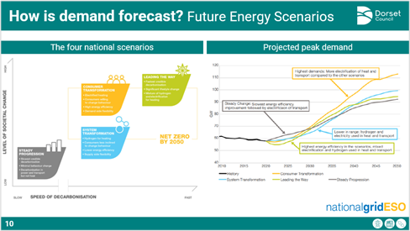
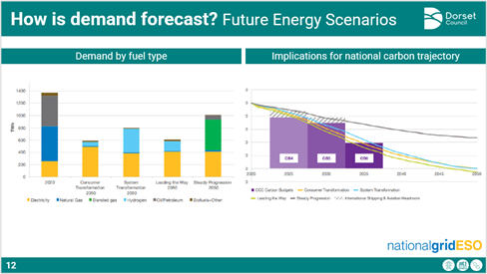
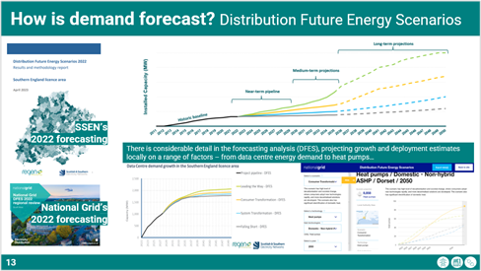
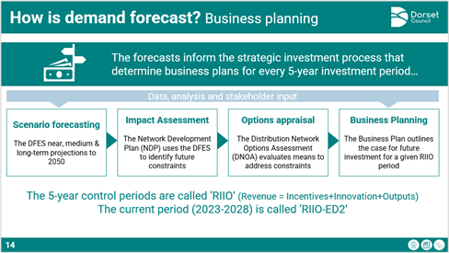
Structure of the process
Session 1:
Session 2:
Session 3:
Session 4:
Session 5:
What the grid is
How the grid is changing
What network operators are
How forecasting, network planning & investment works
What are the constraints locally
How is policy changing

Slide 12
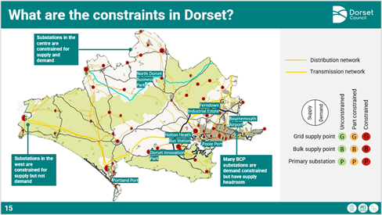
Structure of the process
Session 1:
Session 2:
Session 3:
Session 4:
Session 5:
What the grid is
How the grid is changing
What network operators are
How forecasting, network planning & investment works
What are the constraints locally
How is policy changing

Slide 13
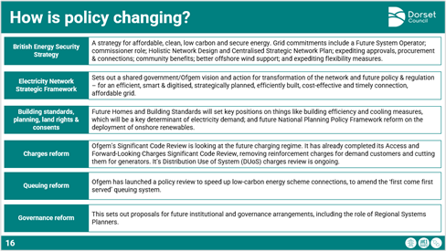
Structure of the process
Session 1:
Session 2:
Session 3:
Session 4:
Session 5:
What the grid is
How the grid is changing
What network operators are
How forecasting, network planning & investment works
What are the constraints locally
How is policy changing

Slide 14


Structure of the process
Session 1:
Session 2:
Session 3:
Session 4:
Session 5:
Q&A
The Q&A session had external independent expert support from…
What the grid is
How the grid is changing
What network operators are
How forecasting, network planning & investment works
What are the constraints locally
This session helped to establish confidence that was indispensable for the evidence-gathering phase. Don’t try to replace this with a written briefing (though that’s a helpful supplement).
How is policy changing

Slide 15
Structure of the process
Session 1:
Session 2:
Session 3:
Session 4:
Session 5:
Dorset’s grid infrastructure
Session 2: Impacts on council activity
The second session was dedicated to:
Elaborating a little more on grid infrastructure, planning and investment
Looking at some case studies from the council’s own projects
Hearing from the experiences of relevant officers
Network planning and investment
Example impacted projects
Case study: EV Chargers
Q&A

Slide 16
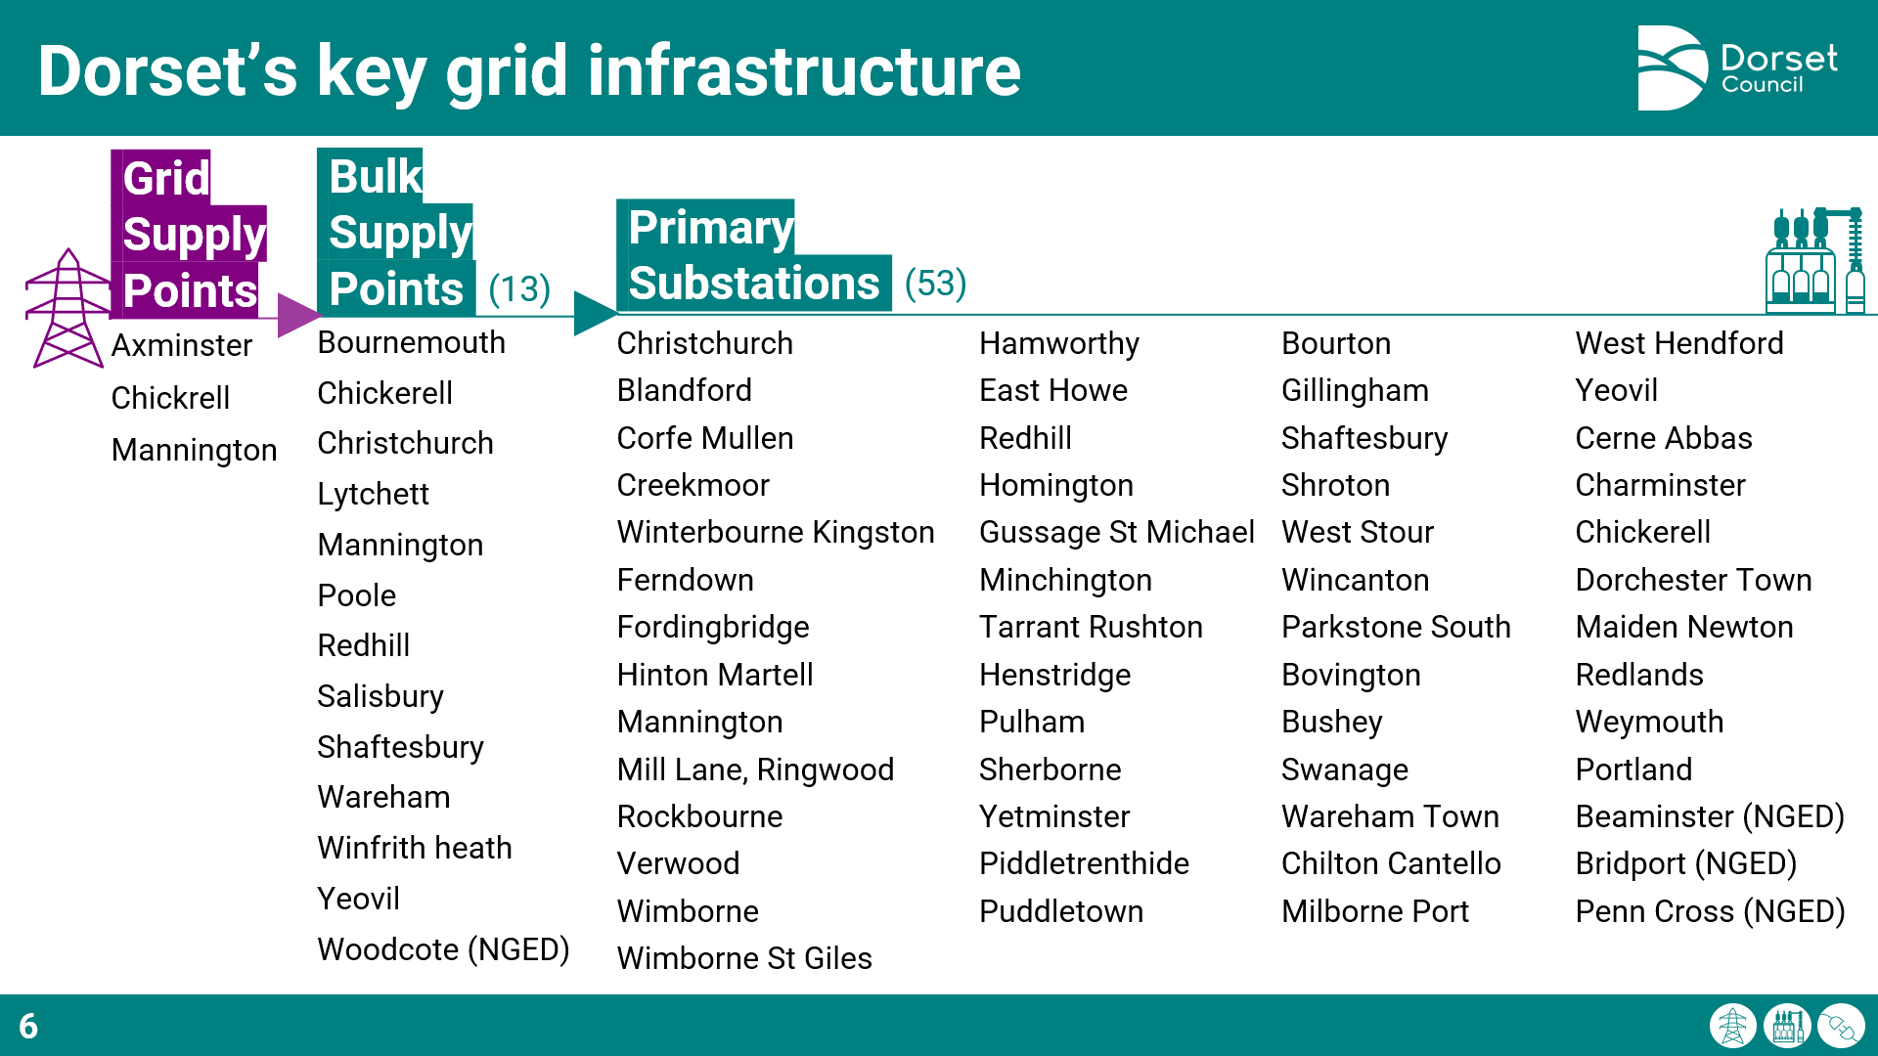
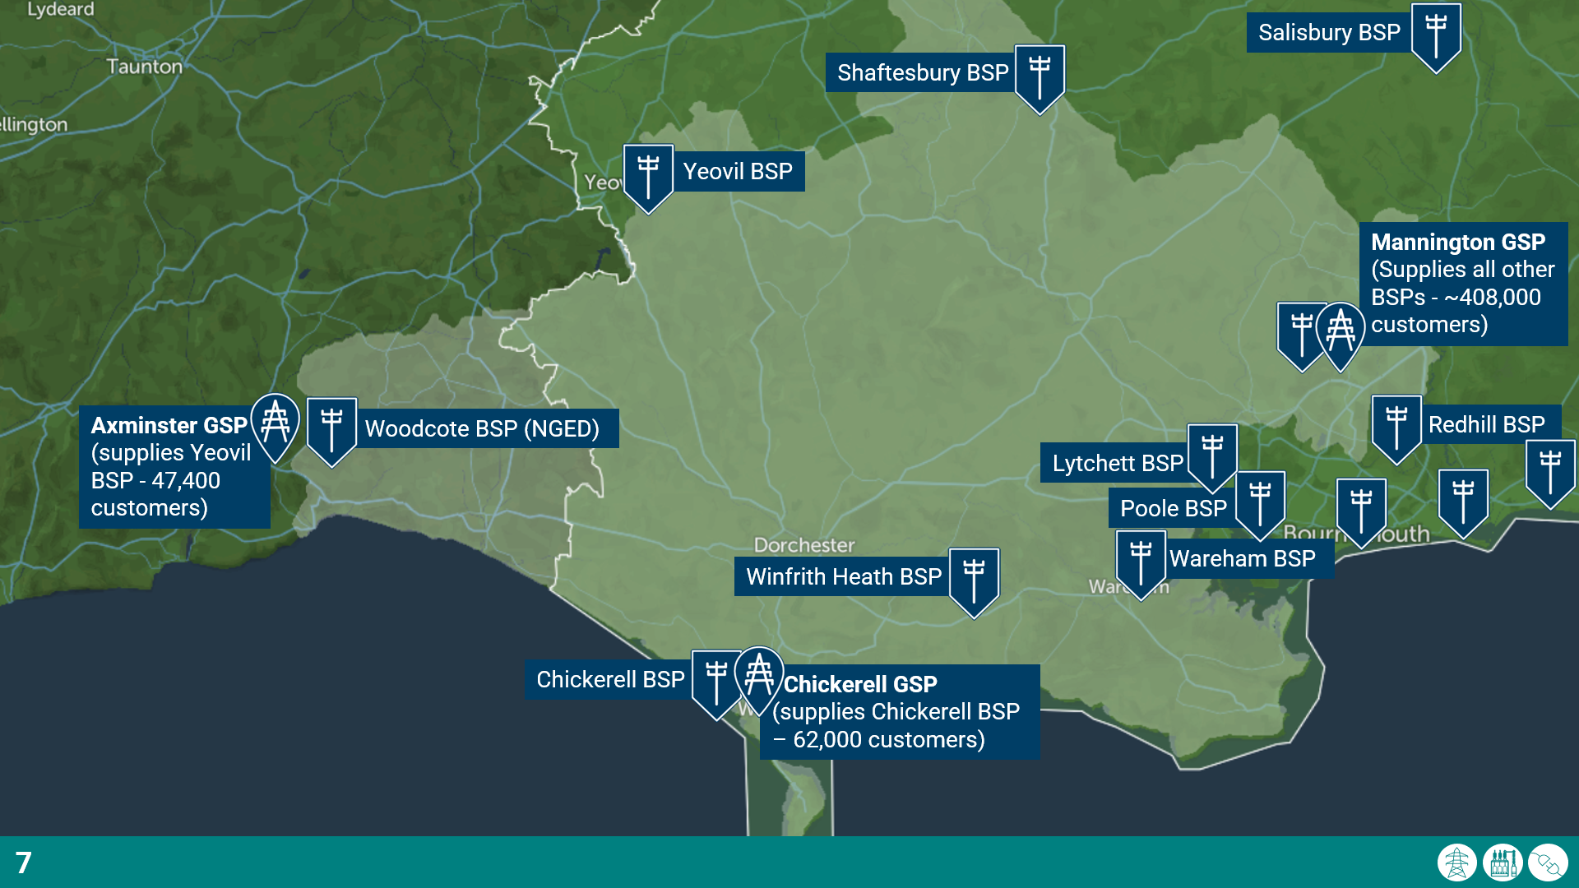
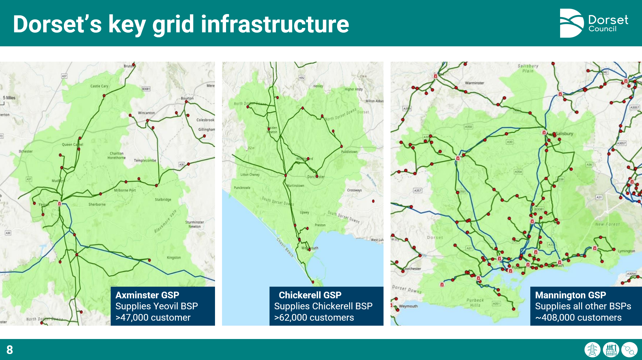
Structure of the process
Session 1:
Session 2:
Session 3:
Session 4:
Session 5:
Dorset’s grid infrastructure
Network planning and investment
Example impacted projects
Case study: EV Chargers
Q&A

Slide 17
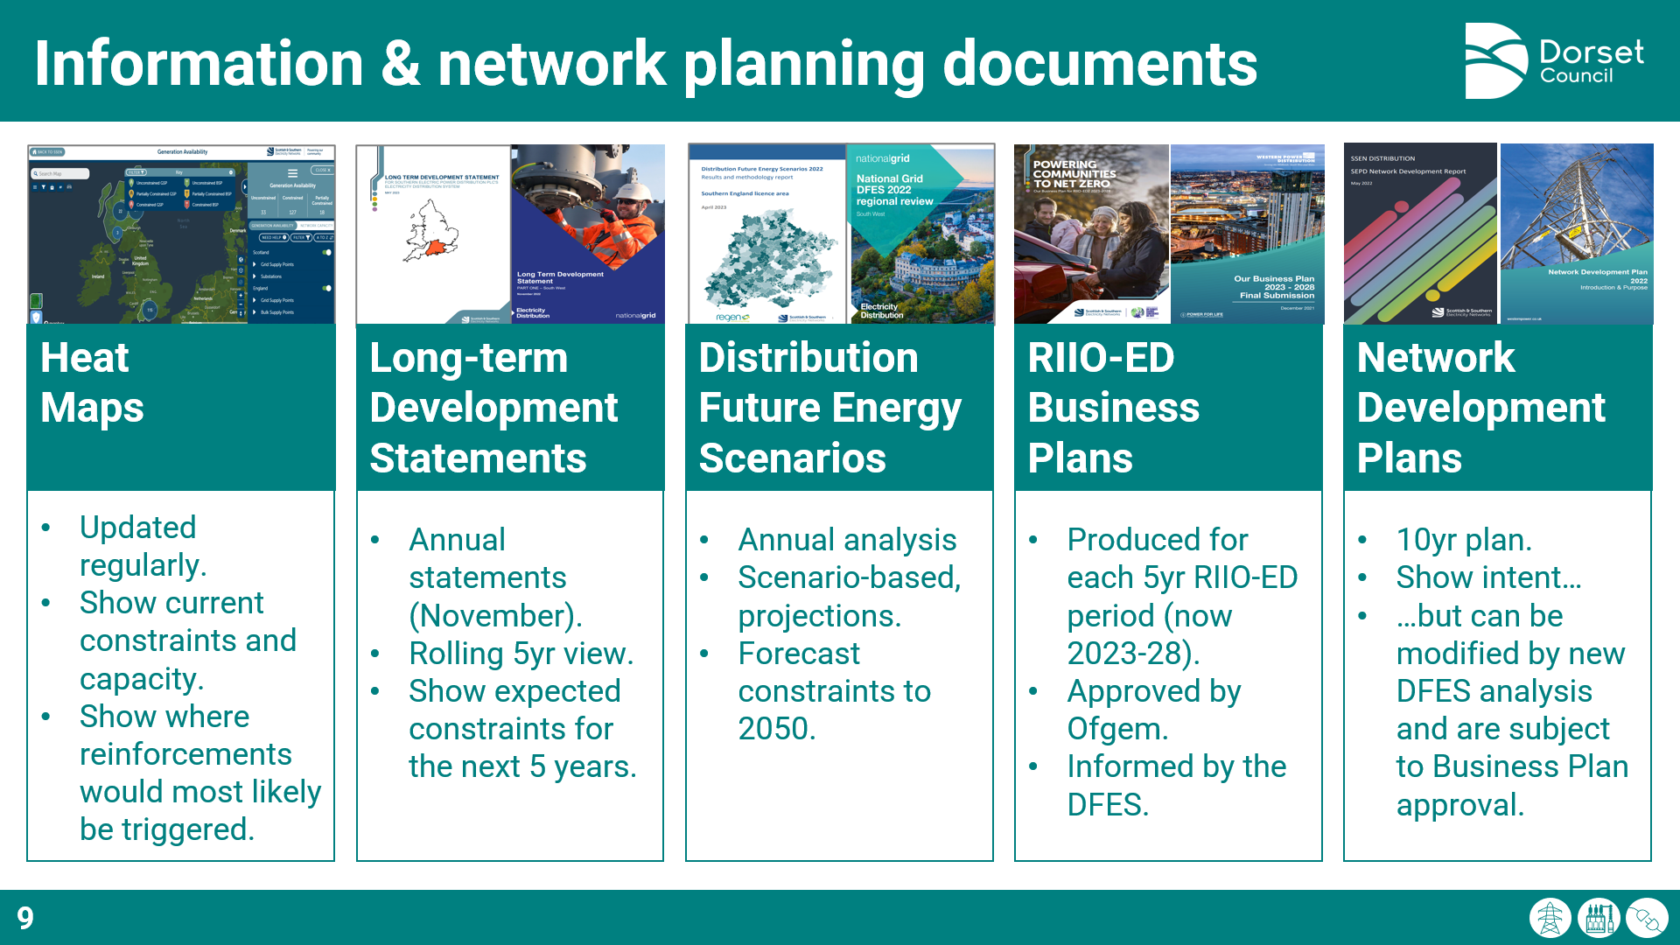
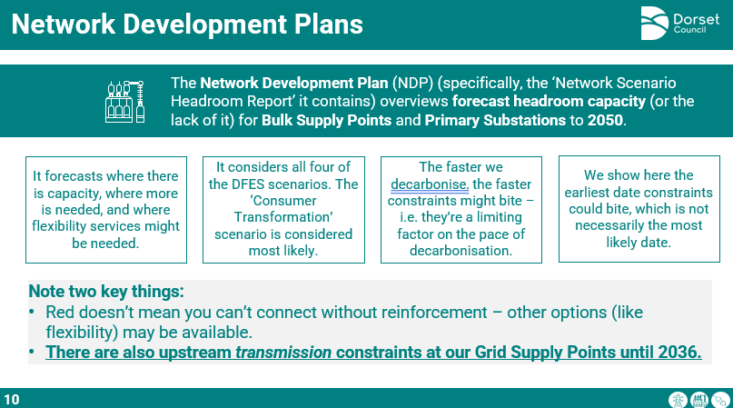
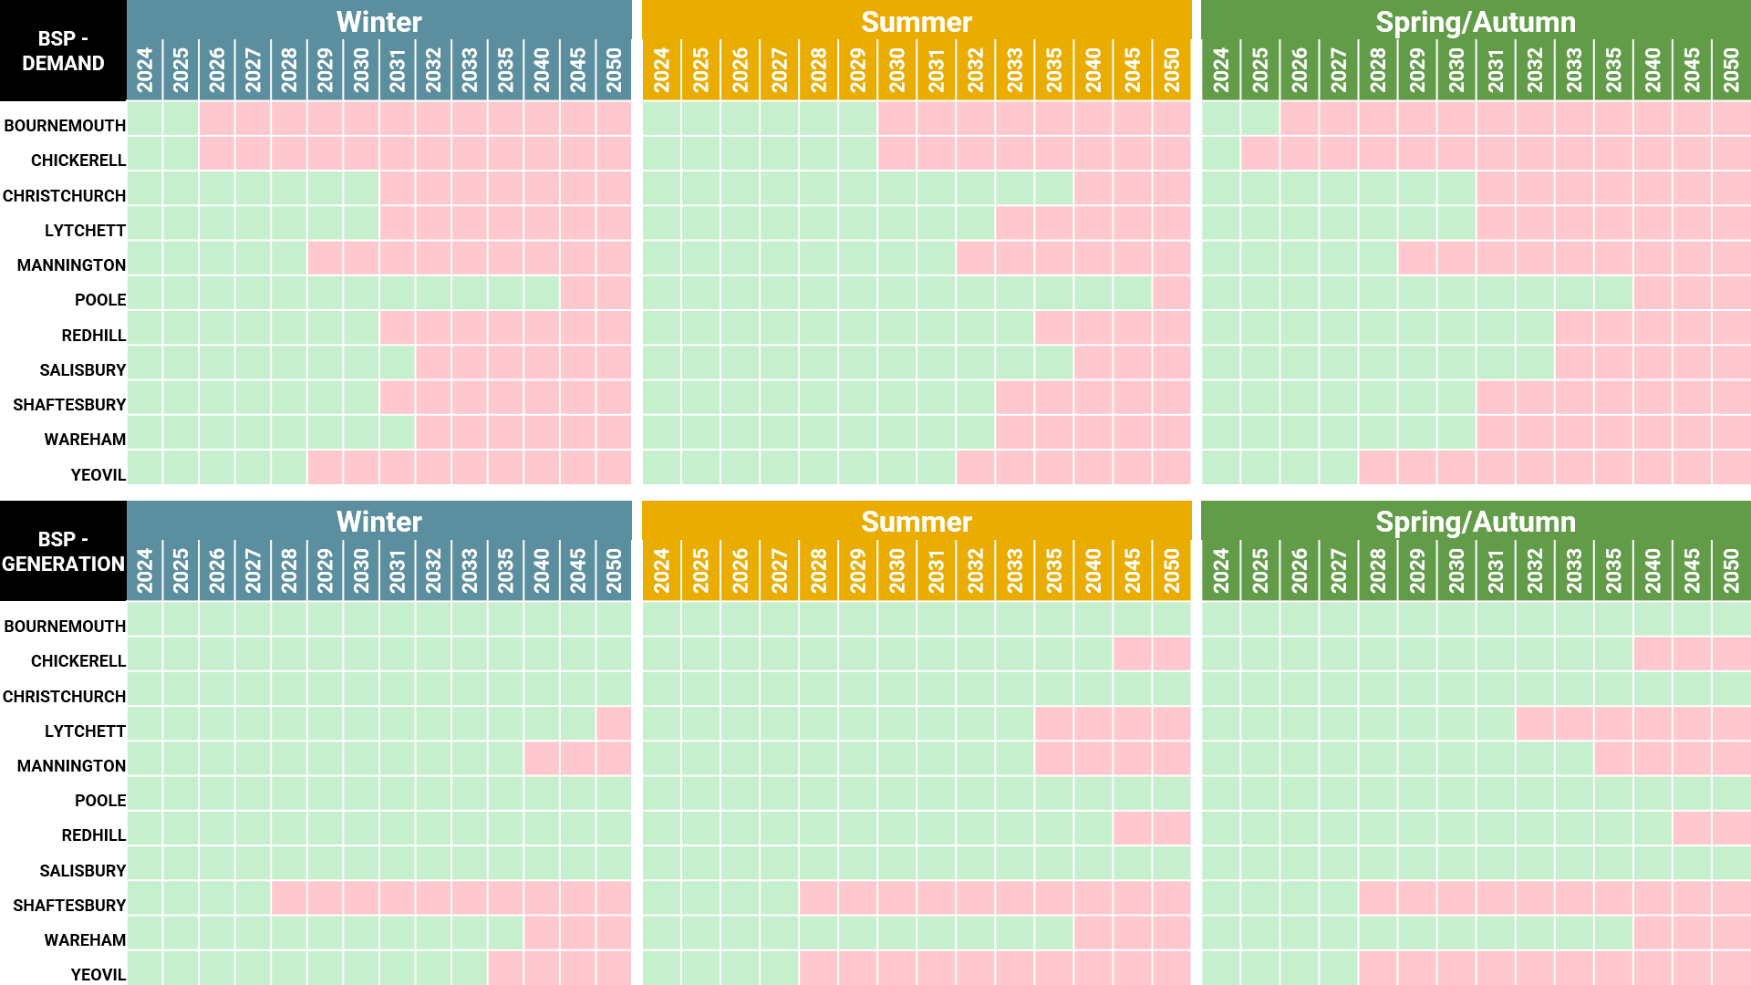
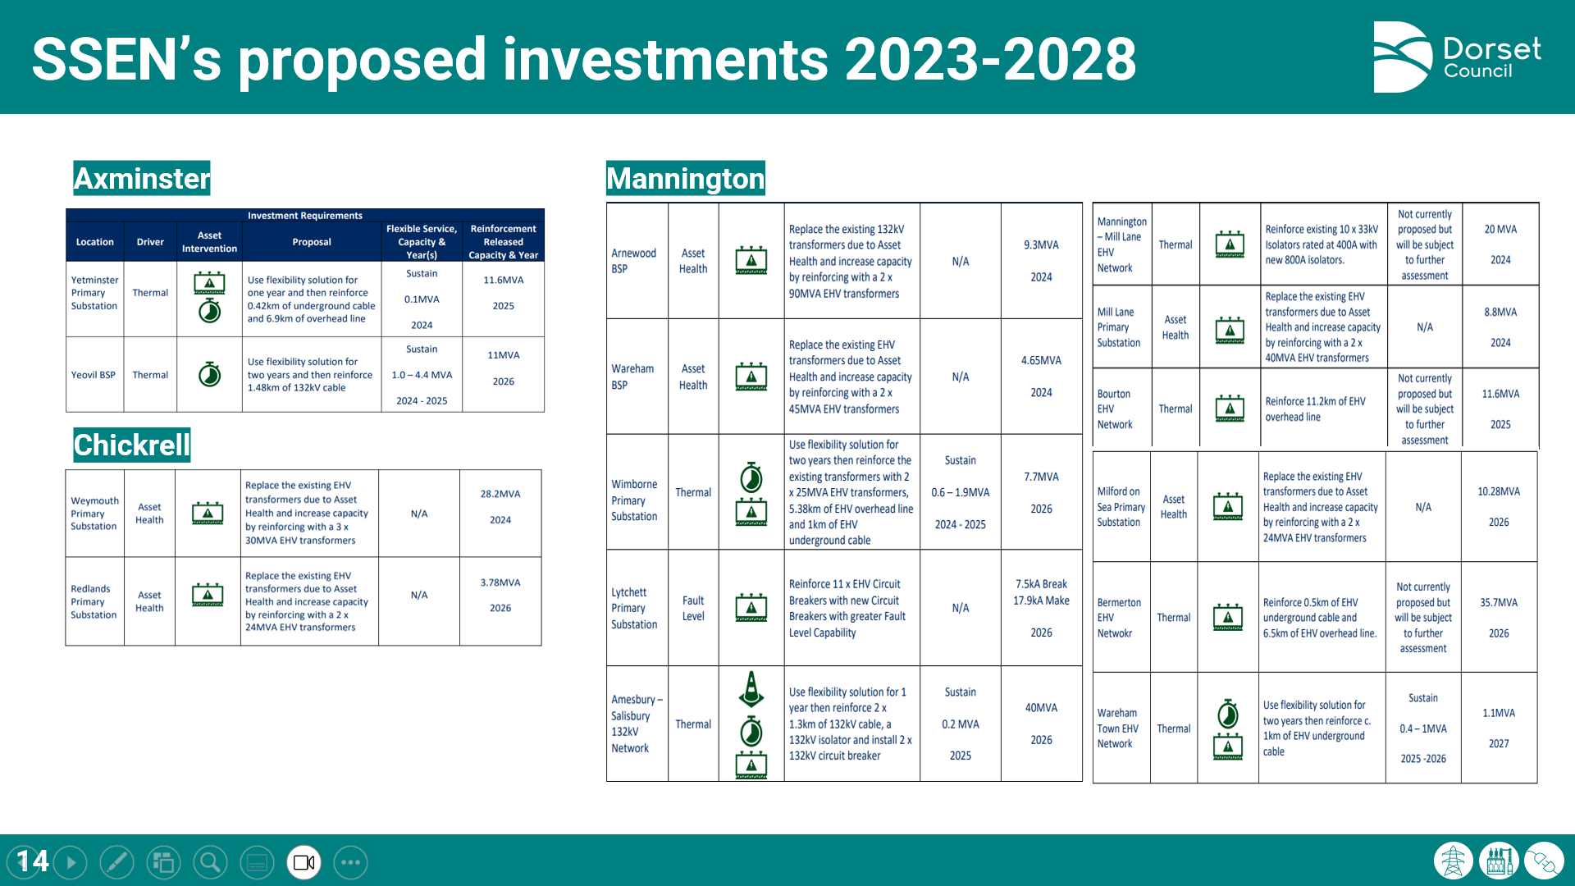
Structure of the process
Session 1:
Session 2:
Session 3:
Session 4:
Session 5:
Dorset’s grid infrastructure
Network planning and investment
Example impacted projects
Case study: EV Chargers
Q&A

Slide 18
Structure of the process
Session 1:
Session 2:
Session 3:
Session 4:
Session 5:
Dorset’s grid infrastructure
Network planning and investment
We examined a set of council projects – from renewables, to EV charger installation, or building heat retrofit – that had been impacted by constraints.
Example impacted projects
Case study: EV Chargers
Q&A

Slide 19
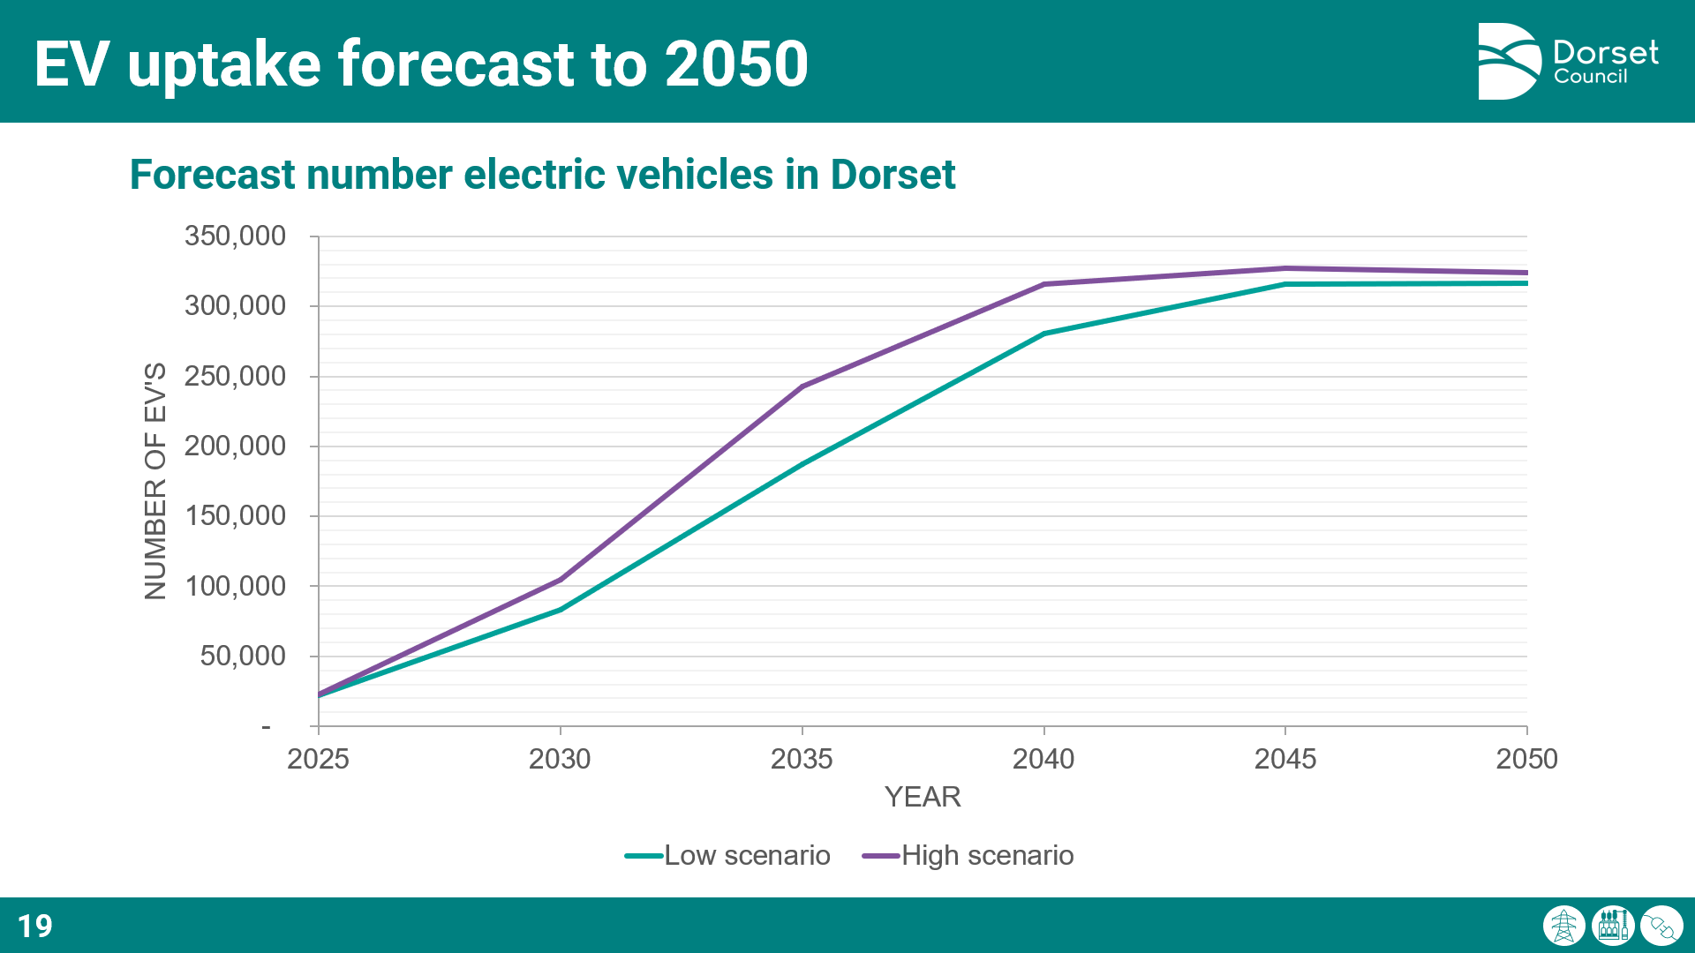
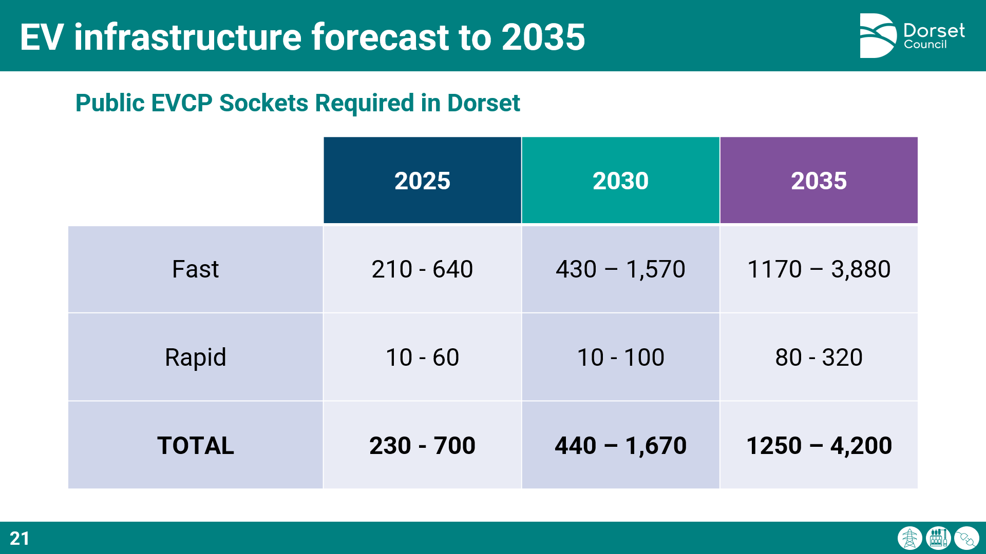
Structure of the process
Session 1:
Session 2:
Session 3:
Session 4:
Session 5:
Dorset’s grid infrastructure
Network planning and investment
Example impacted projects
Case study: EV Chargers
Q&A

Slide 20




Structure of the process
Session 1:
Session 2:
Session 3:
Session 4:
Session 5:
Dorset’s grid infrastructure
Sustainability/Energy team
Estate retrofit team
Planning team
Transport team
Council officer discussion/Q&A included colleagues from…
Network planning and investment
Example impacted projects
Case study: EV Chargers
Q&A

Slide 21
Structure of the process
Session 1:
Session 2:
Session 3:
Session 4:
Session 5:
Renewables, Retrofit and Electric Vehicle Chargers
Session 3: Impacts on wider county projects
The third session was dedicated to hearing from external stakeholders on their experiences, covering:
    Low carbon tech installers
    Public sector and community projects
    High-energy using businesses and economic development
    Housing development
Public sector and community projects
Business & economic development
Housing development

Slide 22
Structure of the process
Session 1:
Session 2:
Session 3:
Session 4:
Session 5:
This session had no initial briefing – it launched straight into four thematic Q&As.
Renewables, Retrofit and Electric Vehicle Chargers
It included participation from:
Dorset Council’s Cabinet
Regen and the South West Net Zero Hub
Large and small scale renewables developers
Retrofitters
EV chargepoint installers
Public sector partners
Community energy initiatives
High energy-using businesses
Economic development representatives
Housing developers and housing associations
Public sector and community projects
Business & economic development
Housing development
They were very easy to get engaged – they were very keen to share on the challenges they’d faced.

Slide 23
Structure of the process
Session 1:
Session 2:
Session 3:
Session 4:
Session 5:
SSEN Intro
Session 4: Network operators
The fourth session was dedicated to engaging with network operators on energy planning & investment, connections processes, reform, and opportunities for better strategic collaboration.
SSEN Q&A
National Grid Intro
National Grid Q&A
Having spent much time discussing the problems, this focused on opportunities. The key thing we wanted to convey was the need to think of energy, development and transport as a triad of interlinked strategic spatial issues in which we have equal strategic interest – and that things like LAEPs and RESPs mean we could play a more central role in strategic energy planning in the future.

Slide 24
Structure of the process
Session 1:
Session 2:
Session 3:
Session 4:
Session 5:
SSEN Intro
Key issues we discussed included…
LAEPs
RESPs
LENZA
Innovation Funding
RIIO-ED2 process and uncertainty mechanisms
SSEN Q&A
National Grid Intro
National Grid Q&A
Data and visualisation
Connections charges
Connections queuing
Ofgem reforms and the Connections & Transmission Action Plans
Business Planning and the shift to anticipatory investment
Key takeaway: Lots of opportunity and enthusiasm for more regular strategic dialogue

Slide 25
Structure of the process
Session 1:
Session 2:
Session 3:
Session 4:
Session 5:
Summary
Discussion on recommendations
Session 5: Review and recommendations
The fifth session recapped and summarised the discussions from the final session – and defined recommendations for Scrutiny and Cabinet.
Notes:
The final session brought together council stakeholders and the scrutiny committee to discuss the findings of the review and discussed recommendations for next steps.

Slide 26
2. Supporting materials

Slide 27
Supporting materials
The review was pretty resource-light – involving only staff time for those involved in the sessions, and my work producing supporting materials and final report.
Most of my time was taken up setting up the meetings, producing these materials and final report – but you could lift a lot of that quite easily.
The process was supported by 4 kinds of supporting material. These are easily replicable for other areas with minimal effort.
Scoping document & terms of reference
Structured agendas, slides and question prompts
Background briefing notes
Issues tracker and narrative

Slide 28
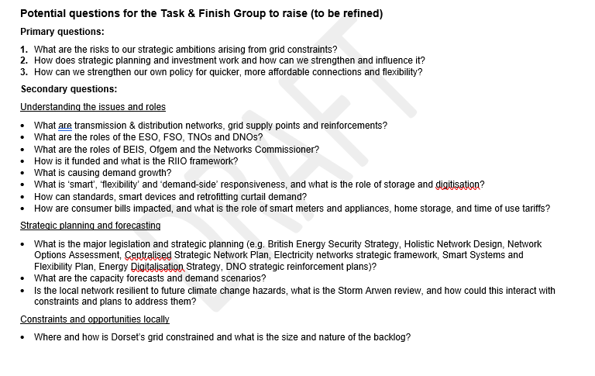
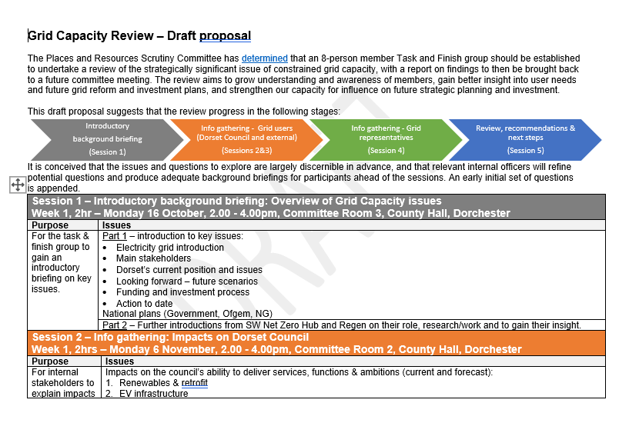
Supporting materials
Scoping document & terms of reference
Structured agendas, slides and question prompts
Background briefing notes
Issues tracker and narrative

Slide 29
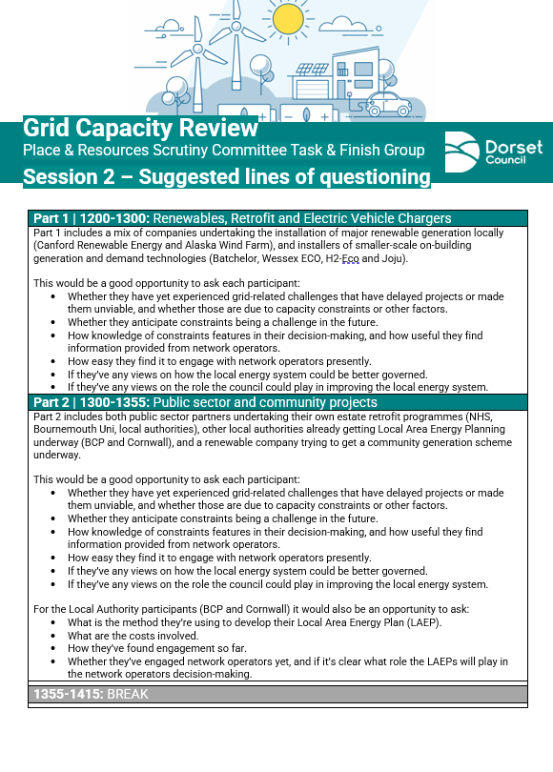
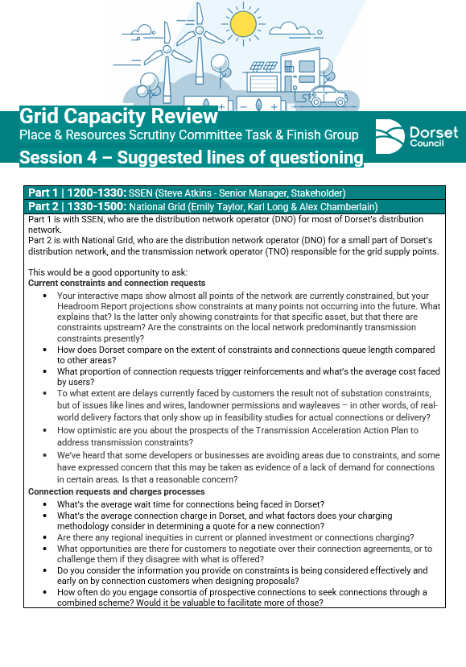
Supporting materials
Scoping document & terms of reference
Structured agendas, slides and question prompts
Background briefing notes
Issues tracker and narrative

Slide 30
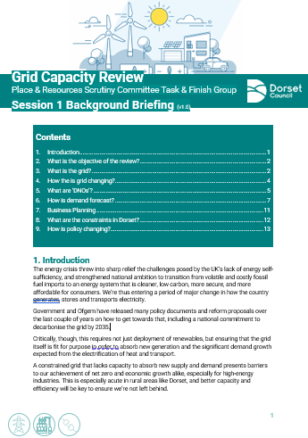
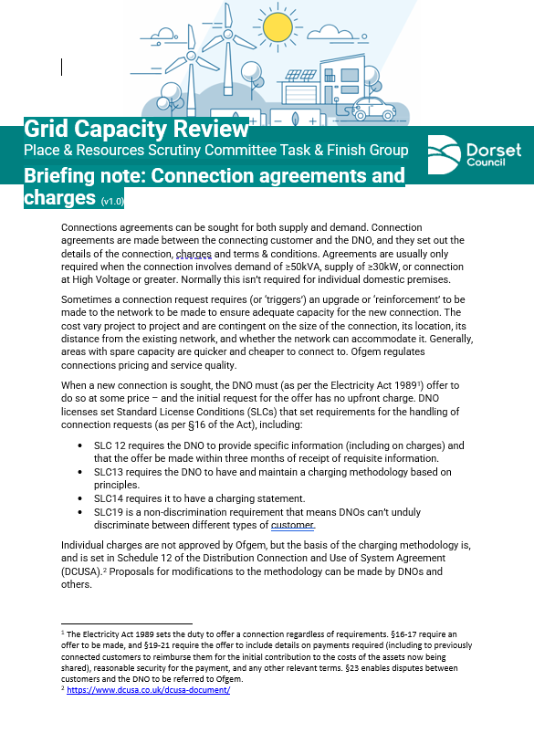
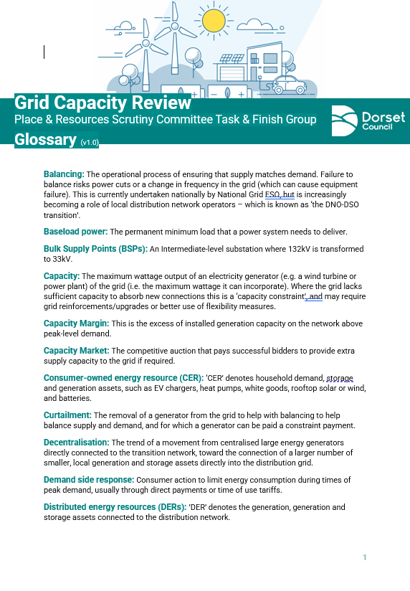
Supporting materials
Scoping document & terms of reference
Structured agendas, slides and question prompts
Background briefing notes
Issues tracker and narrative

Slide 31
Supporting materials
Scoping document & terms of reference
Given the complexity, there was a risk that questioning could go in wildly different directions.
To help participants navigate this, we kept an issues tracker and tried to visualise different lines of inquiry.
That helped to give clarity and a bit of strategic direction to where questioning could go – and supported the chair to keep the discussion structured and focused.
Structured agendas, slides and question prompts
Background briefing notes
Issues tracker and narrative

Slide 32
Supporting materials
An example of one of the earlier issues trackers.
You could reshape this – this just reflects the discussions we had.
7.b. How can we better evidence local need/ambition?
2. What are the current impacts on Dorset?
5.a.i. What does this mean for our strategic ambitions?
7.c. Could we strategically invest in or use our own estate for energy infrastructure?
7.a. How do we prepare for Regional System Planners?
5.a. What are the forecast constraints?
Scoping document & terms of reference
1. What are the current constraints?
3. What are the current impacts on council programmes?
7. How can we enable more strategic grid investment?
5. What is the forecast demand and supply?
Structured agendas and slides
Diagnosis (Current issues)
Prognosis (Future issues)
Solutions
Background briefing notes
4. How do upgrades work presently?
6. What are our local ambitions which will impact future supply & demand?
-Local generation?
-New builds and their standards?
-Retrofitting existing stock & low carbon heating?
-EVs?
-Flexibility tech?
8. What national policy reform is needed that we could lobby for?
Issues tracker and narrative
10.How can we better nurture mitigations in our own policy, and better involve network operators in our strategy/policy development?
9.What local public/business comms & engagement is needed?
4.a. How does anticipatory (forecast-based) strategic investment work?
4.b. How are reactive upgrade asks (new connection requests) handled, prioritised and charged?
8.a. What could we seek in partnership or through devolution?

Slide 33
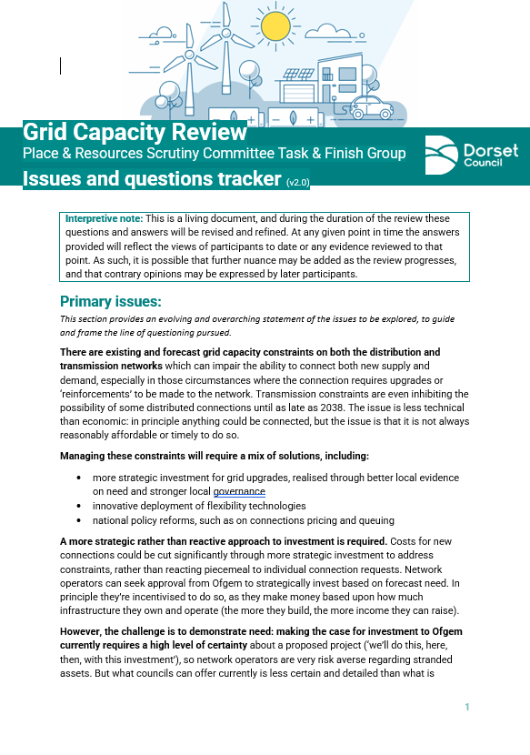
Supporting materials
Scoping document & terms of reference
As well as minutes, we kept this issues and questions tracker.
Essentially this was a narrative long-form version of that previous diagram – which unlike the chronological format of minutes, tried to rationally reconstruct/structure the discussion points.
Structured agendas and slides
Background briefing notes
Issues tracker and narrative

Slide 34
3. Final report

Slide 35
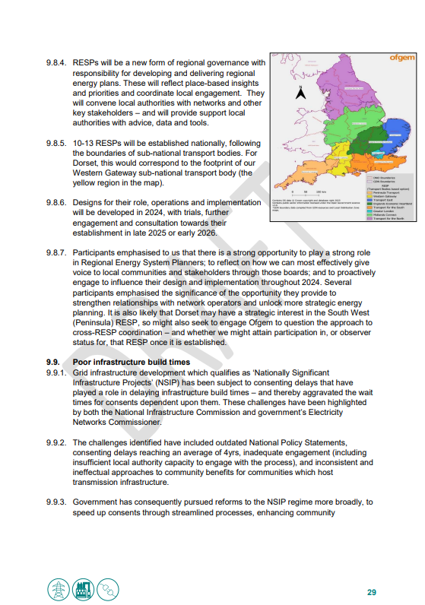
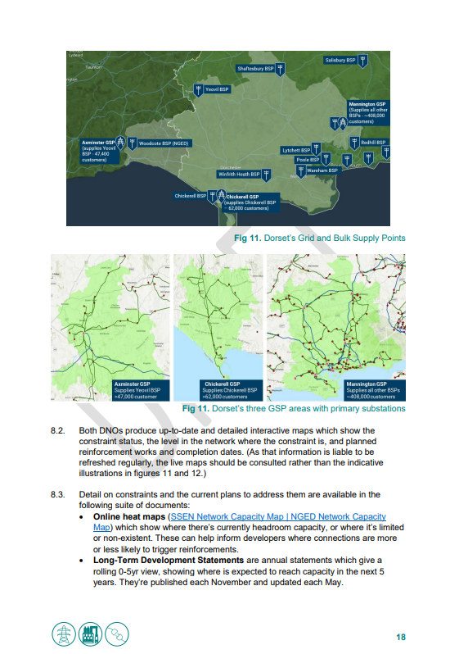
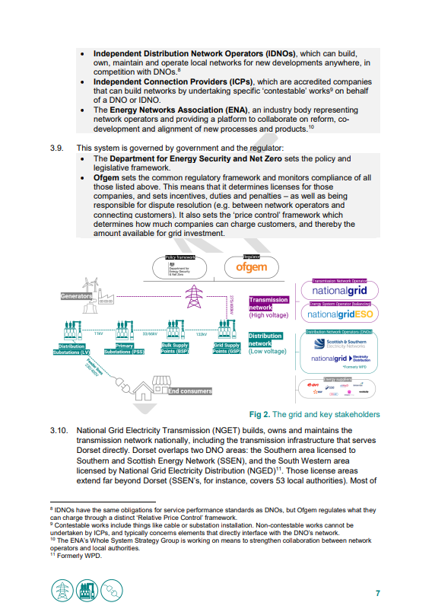
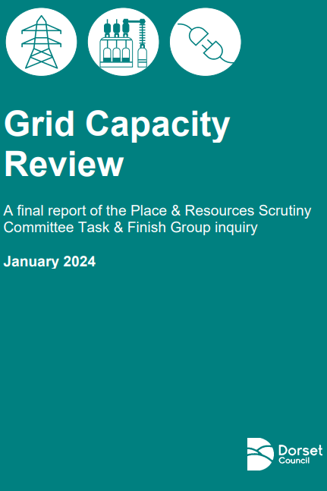
Final report
The final 40 page report contains a summary of the findings, alongside the recommendations from Session 5.
It’s written as a primer for anyone without background knowledge – so should be accessible to anyone who wasn’t engaged in the process.
It also contains briefings on the policy and reform context – which you might find helpful if you need help navigating that.
It’s probably quite easy to replicate to your area with some minor modifications (though you might want to update the narrative on reforms slightly from the last 5 months)
In a nutshell, the report includes…

Slide 36
Final report | Key points
Grid constraints are a drag on decarbonisation, business expansion, development, investment and economic growth.
Local projects already face delays, curtailment or cancellation owing to prohibitive connection costs or grid strengthening delays – and in some cases it has impaired project viability entirely. Some are unable to connect until 2036.
But there are clear strategic opportunities for the council, such as:
Strengthening the evidence base for network investment need and strategic planning
Strengthening collaboration with network companies
Facilitating constraint mitigations like flexibility measures, microgrids, or alternative low carbon heat sources.

Slide 37
Final report | Main issues identified
Extreme delays to 2036 for connection times owing to transmission-level constraints.
A very lengthy queue for connections, and its congestion with often speculative and unviable projects.
More strategic projects often being stuck behind less strategic projects in the queue, owing to non-discrimination requirements in the process.
Delays arising from non-infrastructural factors like wayleaves.
Customer service issues for connecting customers, such as long waits for quotes or the inefficiency of having to manage non-standardised processes that vary across different network operators.
Barriers to connecting due to how impacts of new connections are modelled overestimating risk, particularly for battery storage, and solar PV outside of summer peak.
Requests for significant deposits (e.g. £200k) even for projects that have been given 10-12yr connection dates.
Unclarity about network infrastructure’s precise location or condition, with the risk that further significant challenges can emerge once detailed feasibility work for individual connections is undertaken.
Limited awareness by connecting customers of the extent of competitive demand for connections, to inform decision-making about siting and the worthiness of sinking resource into an application.

Slide 38
Final report | Main impacts identified
Reinforcement costs and delays threatening the timeliness or viability of projects – including risks to renewable deployment, business expansion and development.
Significant project cost uncertainties owing to connection costs tending to increase substantially if requoted (sometimes by tens or hundreds of thousands).
Delayed or deterred investment, particularly in renewable generation.
Constraints to business growth potential or to the siting and relocation of high-energy using industries.
Impediments to plant electrification to decarbonise high-energy industry.
Limits on export rates for renewable generation impairing their income generation potential.
Systemic incentives to install smaller capacity assets (under ‘connect and notify’ rules) in order to avoid the risk of connection delays.
Missed opportunities to install heat pumps when boilers need replacing due to the risk of connection delays, with the result that new gas boilers are locked in.
Knock-on strategic economic risks, such as for investment in renewables, or to the tourism economy through impediments to EV charger provision or shore power/cruise electrification – and risk of exacerbating rural/urban disparity.
Notes:
Subsequently….
Publication of the Connections and Transmission Action Plans
Establishment of NESO and the publication of its Clean Power 2030 report
Connection Reform in 2025 - a new strategic connections process that will impose progress milestones
Ofgem consultation on RESPs

Slide 39
Final report | Main diagnoses
A lack of strategic anticipatory investment
A lack of strategic network planning
Inadequate connection queue processes
Poor coordination and sub-national governance
Poor infrastructure build times
Immature flexibility markets

Slide 40
Final report | Proposed solutions
Better evidencing the local need for network investment.
Forging stronger strategic and collaborative relationships with network operators.
Supporting better strategic planning of the network at a regional and local scale, to better fit local knowledge and ambition on net zero, development and economic growth.
Lobbying on key constraints (e.g. Mannington GSP) to aim to expedite upgrades.
Enabling wider use of constraint mitigation measures, including flexibility measures and energy storage, microgrids, alternative low carbon heat sources like geothermal, energy efficiency measures, and renewable colocation.
Working cross-boundary and at a regional scale to make the case for investment.
Better embedding the issue within local policy framework and decision-making, particularly planning.
Exploring the opportunities for innovation projects and of Ofgem innovation funding.

Slide 41
Final report | Recommendations
Energy infrastructure must be seen through the same lens as other strategic infrastructure, with investment better aligned to local knowledge, ambition and decision-making.
Energy, development and transport are a triad of strategic spatial planning areas in which we have critical strategic interest. Whilst development and transport are more familiar, we’ll have opportunity to play a bigger role in energy in the future.
Our ambitions for net zero, development and economic growth will require us to play a much more central role in local energy planning in the future – and strengthening our collaboration with energy networks will be essential.
1. Establish regular quarterly strategic meetings with network operators
2. Seize the opportunity of Regional Energy Strategic Planners
3. Strengthen the evidence on local investment need through a cost-effective approach to a Local Area Energy Plan
4. Ensure that grid constraints and constraint mitigation measures are embedded in our strategies, policy and decision-making
5. Explore the opportunities of Ofgem’s Strategic Innovation Fund and our devolution asks
6. Lobby our MPs, government, Ofgem and network operators

Slide 42
4. Outcomes and next steps

Slide 43
Main outcomes & next steps
The recommendations were endorsed by Scrutiny and by Cabinet – giving a clear cross-party mandate to proceed with a LAEP. This enabled…
Significantly enhanced understanding for councillors and officers
Confident and vocal advocates amongst councillors – and enthusiasm to develop a LAEP
Recruitment of a new energy officer to take this work forward
Working with our Net Zero Hub and SSEN on developing a LAEP
8
Notes:
Gloucestershire, Wiltshire and Devon – 50k joint budget for stages 1-3

Slide 44
Main lesson
Things like the grid and energy planning, and the associated mass of acronyms and jargon, can make it really hard to get people engaged – because, ultimately, it’s dull and technical.
This was an effective way to animate people’s interest in energy planning: starting with constraint maps and forecasts, alongside real-life local case studies of frustrated connecting customers, does much more to get people to care.
Saying ‘we want to create a strategic spatial plan for energy’ does little to fire anyone up – but hearing many local stakeholders say ‘we can’t connect until 2036’ does.
8

Slide 45
What gets people interested?
Use constraints as an entry point – not renewables or wider energy system issues
Don’t frame is as an energy or net zero issue – keep a broader focus on development, transport and economic risks/impacts
Talk through the failures of the old system – discuss how the shortcomings around strategic planning and investment led us here but that this is exactly what DFESs, LAEPs and RESPs are meant to help solve
Emphasise spatial or urban/rural inequalities or risks – any sense of even the risk of unfairness will get them animated. Show maps, talk about charges and the distribution of investment
Scandal – The single-most said thing was ‘2036’, and they kept comparing it as an analogue overflow pollution. Use that sense of scandal to motivate the reforms and strategic energy planning.
Tie to existing statutory roles – emphasise development, transport and energy as a spatial planning triad.

Slide 46
Replicating this for your area
If you want to replicate this…
Read the final report as a primer to begin (2-3hrs)
Pitch it to one of your scrutiny committee’s (or another suitable group of members) (1-2hrs)
Tweak the materials to make them suitable to your area (3-4hrs)
Find a suitable set of local stakeholders to participate (3-4hrs)
The above should be achievable in a day or two.
Combined with holding the sessions themselves, it should take no more than a week’s worth of your time.
8

Slide 47
Thanks
carl.warom@dorsetcouncil.gov.uk

